Slide 1
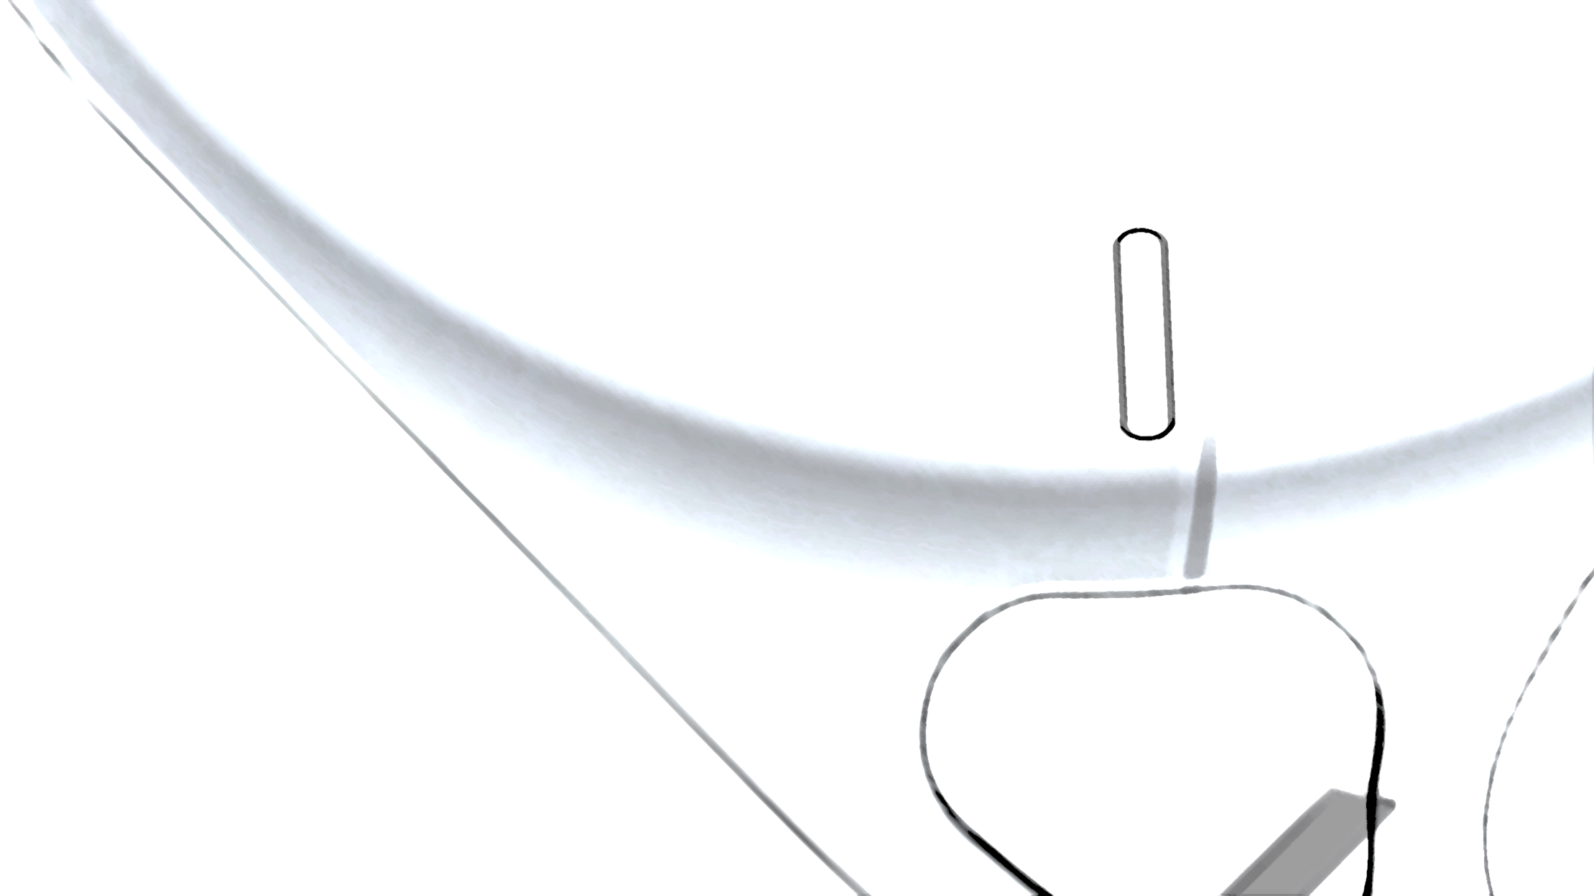


IOL EDITION

Slide 2
Panel
Monofocals
Monofocals?
Multifocals
Edof
Icls and acs
Principles
$200
$200
$200
$200
$200
$200
$400
$400
$400
$400
$400
$400
$600
$600
$600
$600
$600
$600
$800
$800
$800
$800
$800
$800
$1000
$1000
$1000
$1000
$1000
$1000

Slide 3

Some say “natural”, others say “yellow”; this Acrysof lens is the tinted version of SA60WF
Monofocals· $200
Advance Slide for Answer

Slide 4
SN60WF
Monofocals· $200

Slide 5
The Polyvinylidene Fluoride (PVDF) haptics of this 3-piece IOL are more tolerant to manipulation than PMMA haptics
Monofocals · $400
Advance Slide for Answer

Slide 6
CT LUCIA 202/602
(spheric/aspheric)
Monofocals · $400

Slide 7
Named for the unpolished haptic, this Tecnis model resulted in better Toric outcomes than its precusor
Monofocals · $600
Advance Slide for Answer

Slide 8
ZCUx
Monofocals · $600

Slide 9
DCB00 is to ZCB00 as _ is to MX60E
Monofocals · $800
Advance Slide for Answer

Slide 10
MX60PL (enVista Preload)
Monofocals · $800

Slide 11
The two major meniscus (minus) PCIOLS
Monofocals · $1000
Advance Slide for Answer

Slide 12
Sensar (J&J): AR40M
Expand (Acrysof): MA60MA
Monofocals · $1000

Slide 13
This Tecnis monofocal IOL uses EDOF technology to improve depth of focus but it doesn’t quite qualify as a full EDOF lens by FDA standards
Monofocals? · $200
Advance Slide for Answer

Slide 14
Eyehance (Tecnis): DIB00
Monofocals? · $200

Slide 15
Refractive miss? Not any more, this silicone lens can change powers with UV light
Monofocals? · $400
Advance Slide for Answer

Slide 16
Light Adjustable Lens (RxSight): RxLAL
Monofocals? · $400

Slide 17
This nonfoldable PMMA is great for open sky cases, eyelets are included
Monofocals? · $600
Advance Slide for Answer

Slide 18
CZ70BD (Alcon)
Monofocals? · $600

Slide 19
Used in Microincision Cataract Surgery, this lens can be injected through a 1.8mm wound
Monofocals? · $800
Advance Slide for Answer

Slide 20
Akreos MICS (B&L): MI60P
Monofocals? · $800

Slide 21
A new German IOL, this monofocal has a defocus curve similar to that of Tecnis Eyhance
Monofocals? · $1000
Advance Slide for Answer

Slide 22
RayOne EMV (Rayner): RAO200E
Monofocals? · $1000

Slide 23
A bifocal with posterior diffractive rings
Multifocals · $200
Advance Slide for Answer

Slide 24
Tecnis Multifocal (Tecnis):
ZMB00
ZLU𝑥 _{(toric)}
Multifocals · $200

Slide 25
While not truly multifocal, this lens was meant to accommodate and provide usable near vision
Multifocals · $400
Advance Slide for Answer

Slide 26
Crystalens/TruLign Toric (B&L):
AO1UV
BL1UT (toric)
Multifocals · $400

Slide 27
The only true trifocal on the market
Multifocals · $600
Advance Slide for Answer

Slide 28
Panoptix (Alcon):
FAT00/TFNT00
TFAT𝑥/TFNT𝑥 _{(toric)}
CCWTT0/𝑥 _{(Clarion)}
Multifocals · $600

Slide 29
The Synergy (Tecnis) IOL uses diffractive multifocal optics for the _ portions of vision
Multifocals · $800
Advance Slide for Answer

Slide 30
Distance
Multifocals · $800

Slide 31
While rarely used, this is the last premium lens with anterior rings
Multifocals · $1000
Advance Slide for Answer

Slide 32
ReSTOR (Alcon): MN6AD1
Multifocals · $1000

Slide 33
This not-quite EDOF Tecnis monofocal has the model number _ for Torics
EDOF · $200
Advance Slide for Answer

Slide 34
Eyhance (Tecnis):
DIUx
EDOF · $200

Slide 35
This IOL has elements of EDOF and diffractive multifocal technology
EDOF · $400
Advance Slide for Answer

Slide 36
Synergy (Tecnis):
DFR00V
DFW𝑥 _{(toric)}
EDOF · $400

Slide 37
The claim to fame of this IOL is use of proprietary non-diffractive
“X-Wave technology”
EDOF · $600
Advance Slide for Answer

Slide 38
Vivity (Alcon):
DFT015/DFT𝑥
CCWET0/𝑥 _{(Clareon)}
EDOF · $600

Slide 39
The Synergy (Tecnis) IOL uses EDOF optics for the _ portions of vision
EDOF · $800
Advance Slide for Answer

Slide 40
Near and intermediate
EDOF · $800

Slide 41
This EDOF lens blocks 360-460 nm in attempt to reduce dysphotopsias
EDOF · $1000
Advance Slide for Answer

Slide 42
Symfony (Tecnis):
ZXR00
ZXT𝑥 (toric
EDOF · $1000

Slide 43
This PC IOL vaults over the natural crystalline lens
ICLs and ACs · $200
Advance Slide for Answer

Slide 44
VISIAN ICL (STAAR):
MICL𝑥
ICLs and ACs · $200

Slide 45
The two major aphakic AC IOLs
ICLs and ACs · $400
Advance Slide for Answer

Slide 46

S122UV/L122UV (B&L) and
MTA𝑥U0 (Alcon)
ICLs and ACs · $400

Slide 47
This phakic IOL attaches to the iris by “enclavation”
ICLs and ACs · $600
Advance Slide for Answer

Slide 48
Verisyse (J&J):
VRSM5US
ICLs and ACs · $600

Slide 49
An ICL must be vaulted _ (distance) over the natural crystalline lens
ICLs and ACs · $800
Advance Slide for Answer

Slide 50
1.0 ± 0.5 K thicknesses
ICLs and ACs · $800

Slide 51
The EVO ICL (STAAR) has a _ µm central port to eliminate need for LPIs
ICLs and ACs · $1000
Advance Slide for Answer

Slide 52
360 µm
ICLs and ACs · $1000

Slide 53
Most acrylic lenses are this to minimize calcifications, there is one major exception
Principles · $200
Advance Slide for Answer

Slide 54
Hydrophobic, Rayner lenses are Hydrophillic Acrylic
Principles · $200

Slide 55
Most multifocal and EDOF lenses rely on this kind of optics
Principles · $400
Advance Slide for Answer

Slide 56
Diffractive
Principles · $400

Slide 57
Most of this manufacturer’s IOLs are “aberration free” and do not introduce spherical aberration correction into the eye’s optical system
Principles · $600
Advance Slide for Answer

Slide 58
B&L
Principles · $600

Slide 59
The average spherical aberration of the cornea
Principles · $800
Advance Slide for Answer

Slide 60
+ 0.27 μm
Principles · $800

Slide 61
The spherical aberration correction for Tecnis and Acrysof respectively
Principles · $1000
Advance Slide for Answer

Slide 62
-0.27 μm and -0.20 μm
Principles · $1000

Slide 63

Winner!

